Slide 1

Vel Tech Rangarajan Dr. Sagunthala R&D Institute of Science and Technology
School of Computing
Department of Computer Science and Engineering
10211CS224 / FULL STACK APPLICATION DEVELOPMENT (JAVA)
END SEMESTER PROJECT REVIEW
Date: 06-05-2026
JOB PORTAL MANAGEMENT SYSTEM
SDG: SDG No – SDG 9 – Industry, Innovation and Infrastructure
Presented By:
A.Ashwin HaraTeja– VTU26093 – Reg.No.23UECS0667
Courses Handling Faculty:
Dr. Hafizur Rahman- B.E., MTech., Ph.D.

Slide 2
INTRODUCTION
• Managing job applications manually can lead to confusion, missed opportunities, and poor coordination between students and employers.
• In today’s digital world, connecting job seekers and employers efficiently is very important.
• This project aims to provide a simple and efficient Job Portal Management System.
• The system improves communication between students and employers through notifications and updates.
• It ensures a smooth and organized recruitment process.
• The application is built using Spring Boot, Thymeleaf, and MySQL.
• This project demonstrates real-world web application development, CRUD operations.
1
2
3
4
5
6
7
8
9

Slide 3
PROBLEM STATEMENT
• Manual handling of job applications often leads to confusion and miscommunication between students and employers.
• Job seekers may miss important job opportunities due to the absence of a centralized platform.
• Application processes are not well organized and can result in data loss or missed tracking.
• Job details are not easily accessible to all students in a structured way.
• Managing multiple job postings and applications manually becomes time-consuming for employers.
• Lack of proper communication regarding application status (shortlisted/rejected) affects user experience.
• No efficient system to update or delete job postings dynamically.
• Difficulty in tracking applied jobs and monitoring recruitment progress.
1
2
3
4
5
6
7
8
9

Slide 4
OBJECTIVE(S)
• To develop a Job Portal Management System for efficient recruitment and job application handling.
• To allow students to view all available job opportunities in a centralized platform.
• To enable students to apply for jobs easily through an online system.
• To provide a system for tracking application status (Applied, Shortlisted, Rejected).
• To allow employers to post, update, and delete job listings.
• To manage all user, job, and application data in a structured database.
• To improve communication between students and employers through notifications.
• To reduce manual work and streamline the hiring process.
• To build a real-time, user-friendly web application using modern technologies.
1
2
3
4
5
6
7
8
9

Slide 5
PROPOSED SYSTEM
1
• The proposed system is a web-based Job Portal Management System developed using Spring Boot, Thymeleaf, and MySQL.
• It allows students to view all available job opportunities and access job details in a centralized platform.
• Students can easily apply for jobs and track their application status through an online system.
• Employers can create, update, and delete job postings dynamically using the system.
• All user, job, and application data are securely stored in a MySQL database.
• The system provides a user-friendly interface for both students and employers.
• It reduces manual work involved in managing job applications and recruitment processes.
• It improves efficiency, transparency, and communication between students and employers.
2
3
4
5
6
7
8
9

Slide 6
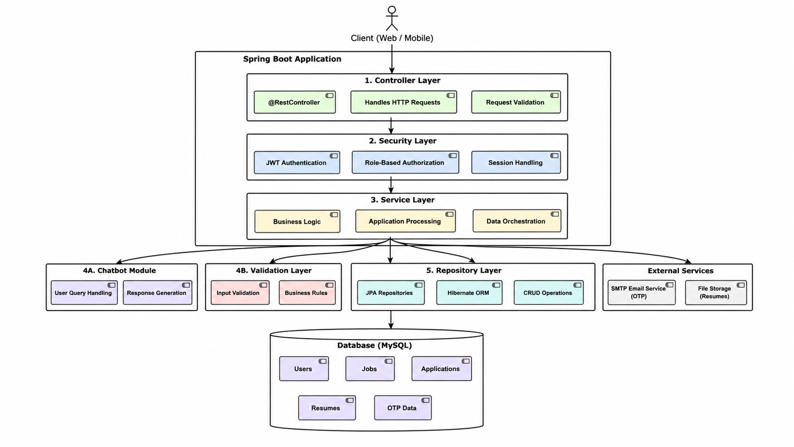
PROPOSED SYSTEM ARCHITECTURE
1
2
3
4
5
6
7
8
9

Slide 7
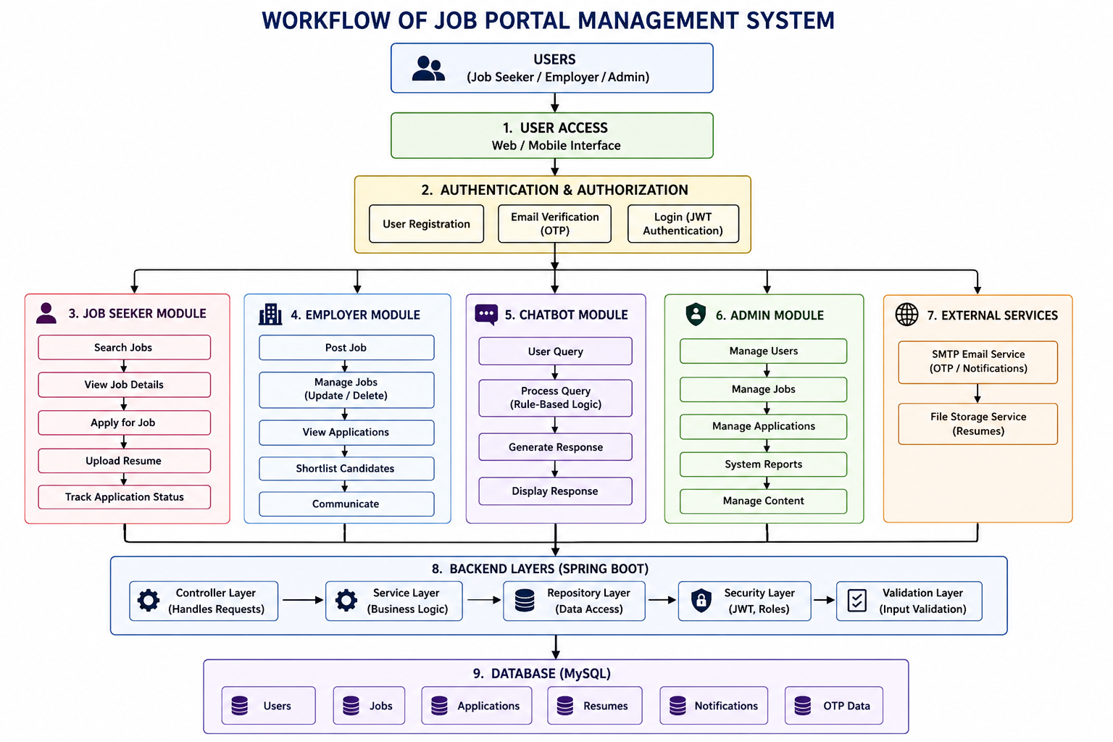
WORKFLOW
1
2
3
4
5
6
7
8
9

Slide 8
TECHNOLOGIES USED
Frontend:
HTML5
CSS3
Thymeleaf
JavaScript (for dynamic interactions and chatbot)
Backend:
Spring Boot
Spring MVC
Spring Security
Java Mail Sender (for Email Verification / OTP)
Database:
MySQL
H2 Database (for development/testing)
Server:
Apache Tomcat Server
Tools:
Visual Studio Code / IntelliJ IDEA
MySQL Workbench
Postman (API Testing)
Web Browser (Google Chrome)
Hardware / Software Requirements:
System Requirements:
Operating System: Windows 10 or above
RAM: Minimum 4GB (Recommended 8GB)
Processor: Intel i3 or higher
Software Requirements:
Java JDK (17 or above)
Apache Tomcat Server
MySQL Server
Maven (Build Tool)
1
2
3
4
5
6
7
8
9

Slide 9
MODULE DESCRIPTION
1
Module 1: User Authentication Handles login and registration for Students and Employers using secure authentication. Restricts unauthorized access based on user roles (Student / Employer).
Module 2: Job Management (Employer Side) Allows employers to post new jobs with title, description, skills, salary, and location. Provides options to update and delete job postings using CRUD operations.
Module 3: Student Interaction Allows students to browse available jobs in the system. View detailed job information using web pages and APIs.
2
3
4
5
6
7
8
9

Slide 10
MODULE DESCRIPTION
1
Module 4: Job Application Management Students can apply for jobs through an online form. Students can view and track application status (Applied, Shortlisted, Rejected).
Module 5: Search & Filters Search jobs based on location, skills, and experience. Displays filtered results dynamically for better user experience.
Module 6: Notification System Sends email notifications to students when application status changes. Notifies employers when a new application is received.
2
3
4
5
6
7
8
9

Slide 11
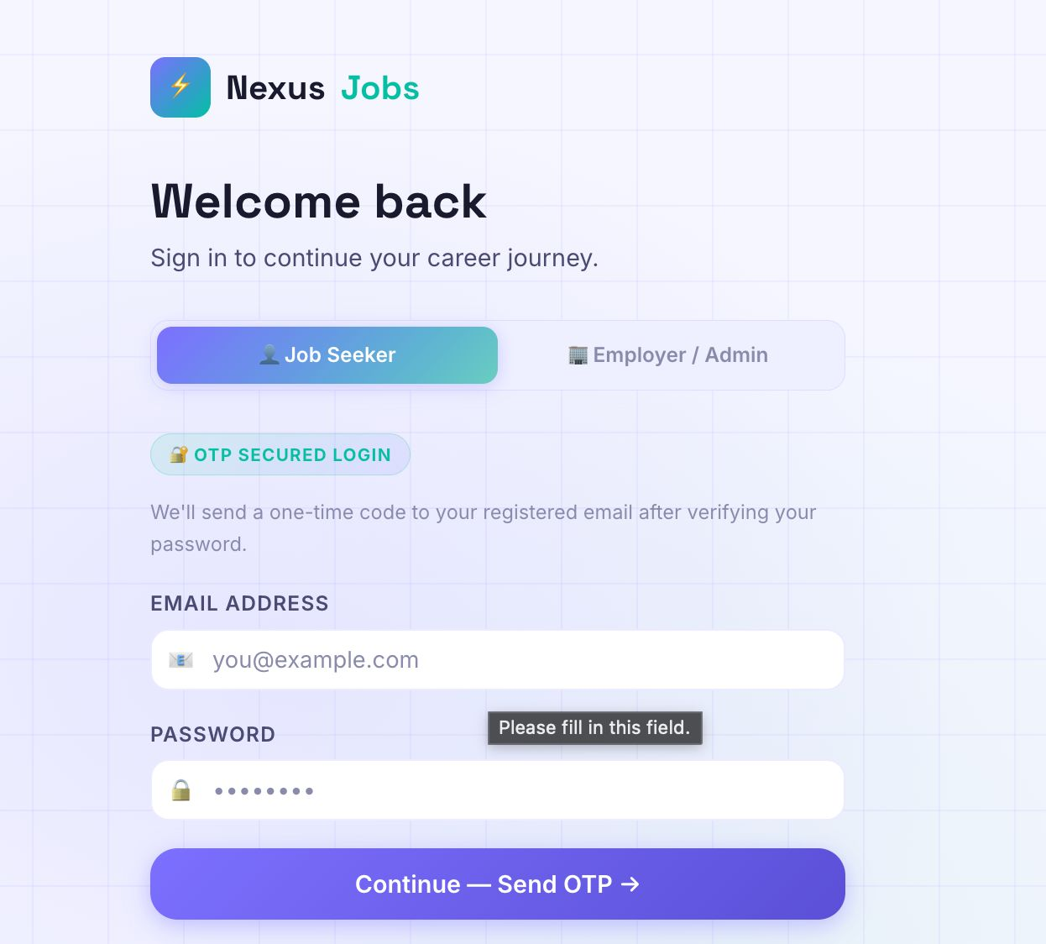
IMPLEMENTATION SCREENSHOTS
1
2
3
4
5
6
7
8
9
This image represents the login interface of the Job Portal Management System, designed with a modern and user-friendly layout. It allows users to securely sign in using their email and password to access personalized features of the platform. The interface also provides an option for new users to register, ensuring easy onboarding.

Slide 12
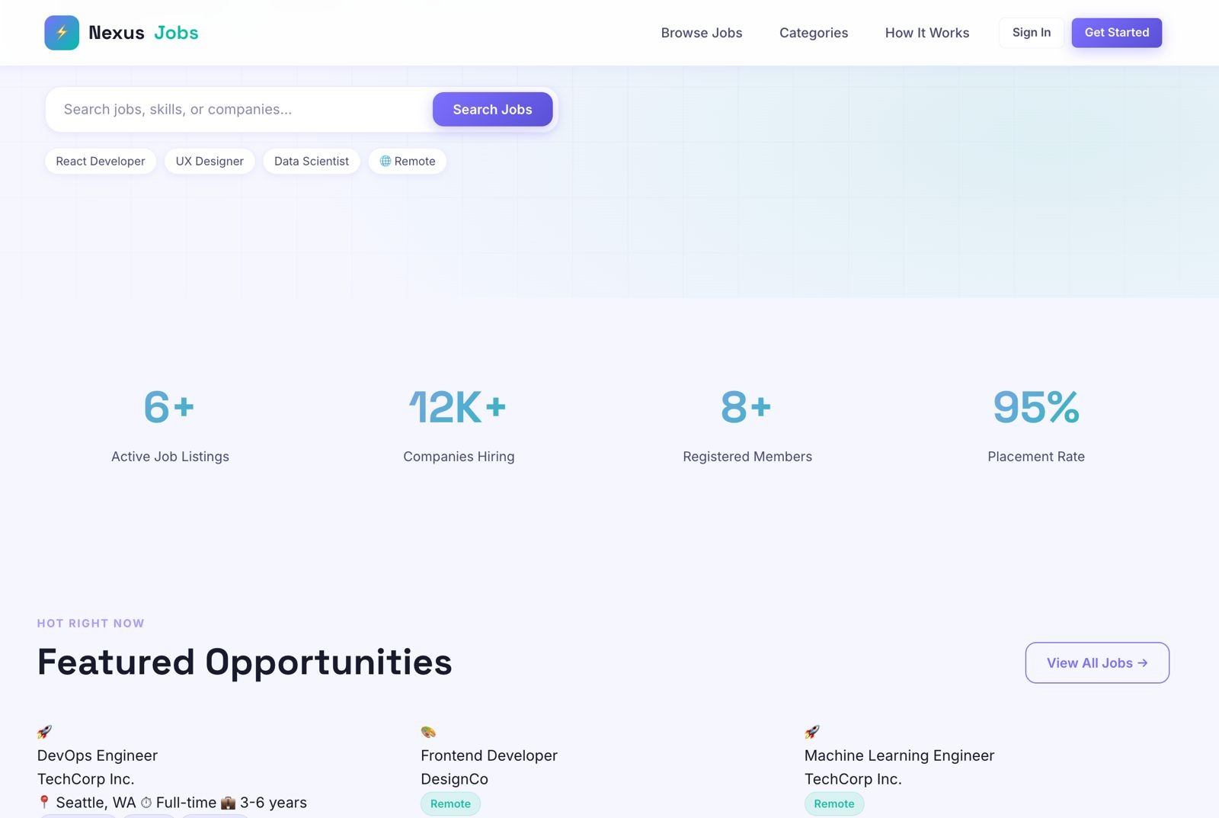
IMPLEMENTATION SCREENSHOTS
1
2
3
4
5
6
7
8(A)
9
This image represents the dashboard of the Job Portal Management System after user login. It displays user profile details, application statistics, and current job application status in a structured interface. The dashboard also provides quick actions like browsing jobs, editing profile, and tracking application progress for better user experience.

Slide 13
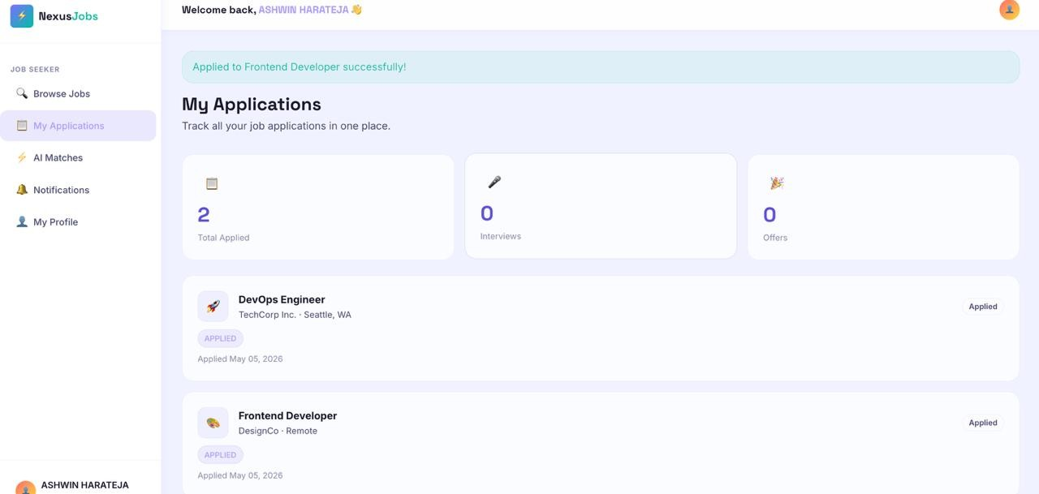
IMPLEMENTATION SCREENSHOTS
1
2
3
4
5
6
7
8(B)
This image represents the employer dashboard of the Job Portal Management System used by companies to manage recruitment activities. It displays key metrics such as job posts, applications, shortlisted candidates, interviews, and hiring status. The interface also provides insights and analytics to help employers track candidate progress and make informed hiring decisions.
9

Slide 14
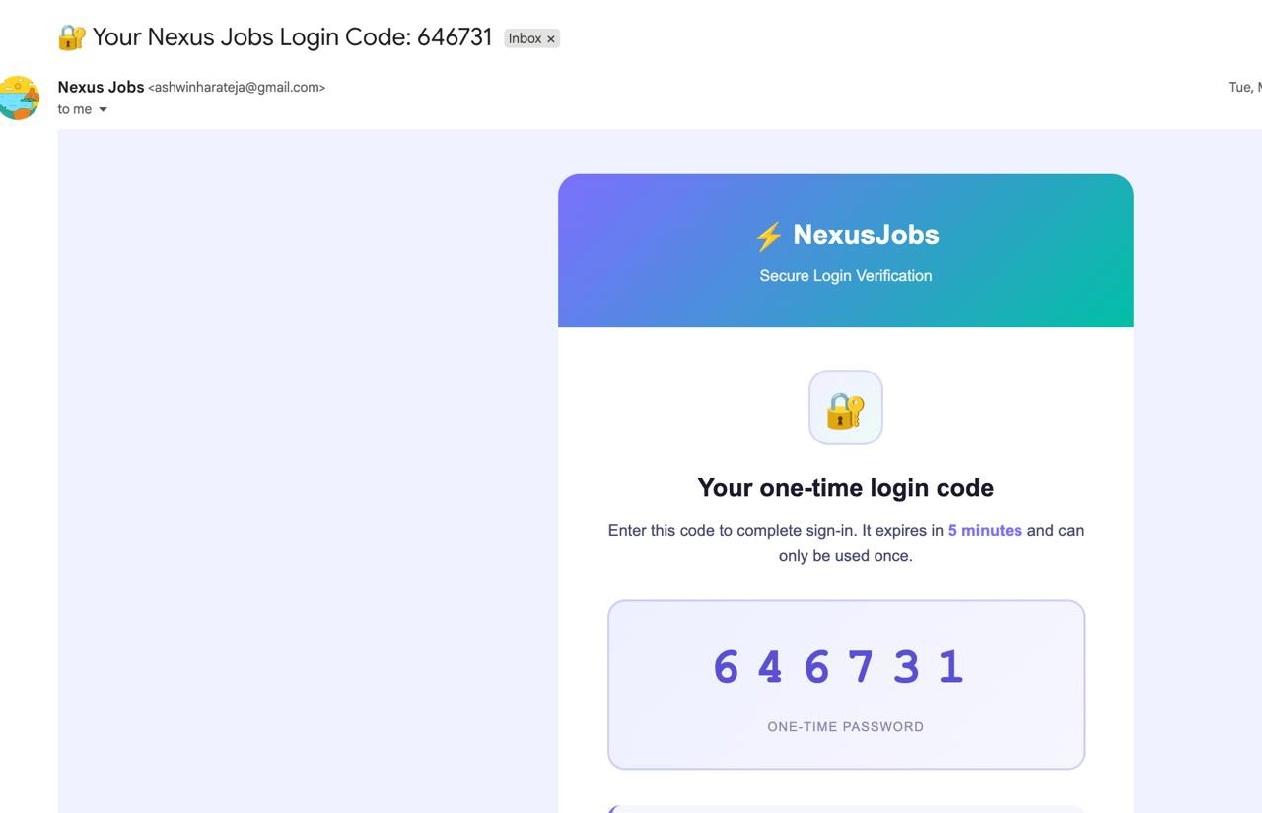
IMPLEMENTATION SCREENSHOTS
1
2
3
4
5
6
7
8(C)
9
This image shows a secure login verification email from the NexusJobs platform, designed to authenticate a user during the sign-in process. The system generates a one-time password (OTP), which is sent to the user’s registered email address to ensure that only authorized individuals can access the account. The OTP displayed in the email is valid for a limited duration of 5 minutes and can be used only once, enhancing security by preventing reuse or unauthorized access.

Slide 15
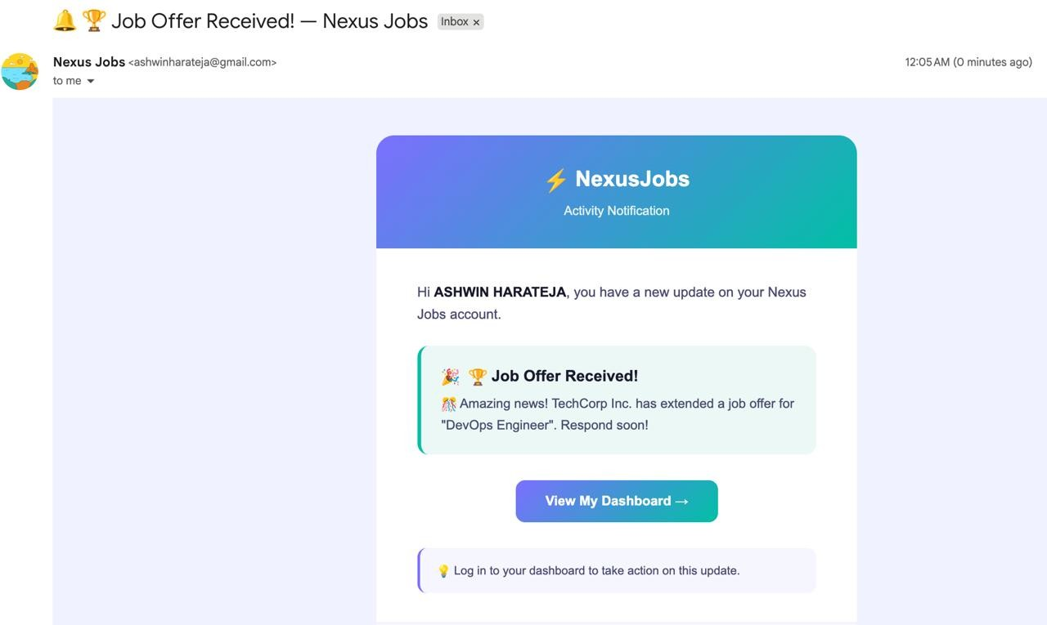
IMPLEMENTATION SCREENSHOTS
1
2
3
4
5
6
7
8(C)
This image shows a professional email notification from Nexus Jobs informing the user about a new job offer. The message is clearly designed with a modern and attractive layout, featuring a gradient header and a structured content section. It greets the user personally and highlights the important update that a company, TechCorp Inc., has extended a job offer for the role of “DevOps Engineer.” The email uses icons and concise text to grab attention and convey excitement. It also includes a clear call-to-action button, “View My Dashboard,” encouraging the user to log in and respond promptly. Overall, the notification demonstrates an effective and user-friendly way of delivering important job-related updates.
9

Slide 16
ADVANTAGES & LIMITATIONS
Advantages:
• Simple and user-friendly interface. • Supports CRUD operations for job and application management. • Role-based access for Students and Employers. • Centralized database for jobs and applications. • Easy job search with filters (location, skills, experience).
Limitations:
• Basic UI without advanced design. • Limited features (no advanced analytics). • Depends on local server setup. • No mobile application support. • Limited scalability for large users.
1
2
3
4
5
6
7
8
9

Slide 17
Thank you

